Slide 1
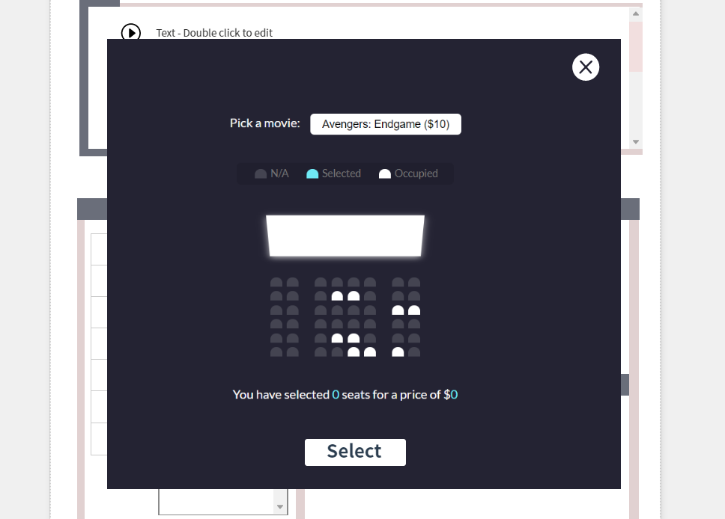

Slide 2
Movie :
0
0
Children
Adult

